Slide 1


Slide 2




Employee Retention Prediction
In today’s competitive job market, employee retention has become a critical challenge for organizations.
High turnover among employee not only increases hiring costs but also disrupts project continuity and team efficiency.
This project focuses on predicting whether employees are likely to seek a job change based on factors such as experience, training hours, company size, and previous job change history.
A predictive machine learning model is developed to identify employees who are more likely to switch jobs.
The project analyzes key factors influencing job change decisions to understand employee behavior.
The insights generated can help organizations design effective retention strategies and improve workforce planning.
Presented By :Afifa Tarafder

Slide 3


Introduction
02
Data Preprocessing
01
Reason causing Employee Retention Prediction is for predict job change likelihood.
Comprehensive Dataset Overview
03
EDA
04
Feature Extraction
Find patterns visualizations to understand feature distributions and their relationship with job change behavior.
It transformed and analyzed to improve
model performance and interpretability.
Methodology
Experimental results
05
Multiple classification models were trained and evaluated using accuracy, F1-score, and ROC-AUC metrics.
06
Visuals of Compared models
Accuracy, confusion matrix of models
Conclusion
Appendices and references
07
08
Importance of the used approach
Suggestion for future
Links and codes used in the project

Slide 4

INTRODUCTION
In today’s competitive job market, employee retention is a key priority for organizations.
High employee turnover increases recruitment costs and disrupts overall productivity.
This project applies machine learning to predict whether employees, are likely to change jobs.
Prediction is based on multiple factors including experience, training hours, company size, education level, and job change history.
The developed predictive model helps identify employees with a high likelihood of switching jobs.
Insights from this analysis can help improve retention strategies and workforce planning.

Slide 5






Objective OF The Study
Risk Stratification
Comparing Algorithms
Real - time Monitoring
Value Of The Study
Early Identification & Prevention
Improved Workforce Stability
Strategic HR Decision-Making

Slide 6


Prediction & Monitoring
Applied the best-performing model to the test dataset to predict potential job changes and support HR decision-making.
STEP
07
Model Evaluation
STEP
Evaluated models using Accuracy, Precision, Recall, F1-score, ROC-AUC, Confusion Matrix, and ROC curves to compare performance.
06
Model Selection and Model Training
STEP
Trained and tuned multiple models including Logistic Regression, Random Forest and XGBoost to predict job change likelihood.
05
WORK FLOW
Train–Validation Split
WORK FLOW
STEP
04
Split the processed training data into training and validation sets to evaluate model generalization. We have another dataset for test.
PREPROCESSING
Handled missing values, encoded categorical features, scaled numeric
-al variables and applied SMOTENC
to address class imbalance.
STEP
03
STEP
Exploratory Data Analysis
02
Analyzed feature distributions, missing values, correlations, and job change patterns using visualizations.
Data Collection
Loaded 2 datasets: train.csv (with target variable) and test.csv (without target) containing employee and job-related information.
STEP
01

Slide 7
1900+
Data Collection & Refinement
Employee Job Change Prediction
14
ROWS
Job Change Dataset
Train and test
Data Set
Data Set Description
Variable | Description
enrollee_id | Enrollement no of the employee
city_development_index | Development index of the city where the candidate resides (higher value indicates better development)
relevent_experience | Whether the candidate has relevant work experience (0 = No, 1 = Yes)
education_level | Highest education level attained by the candidate (encoded categorical variable)
experience | Total years of professional experience of the candidate
last_new_job | Number of years since the candidate last changed jobs
training_hours | Total number of training hours completed by the candidate
target | Job change status (0 = Will not change job, 1 = Will change job)
COLUMNS
Features
(Columns)
Gender
Demographic Information
City
Education Level
Professional Background
Relevant Experience, Major Discipline, Company Type, Company Size
X
Work & Training Details
Training Hours, Enrolled University, City Development Index, Experience Level, Last New Job Duration
Output Variable
Job Change
Status
0: Employee will not change job
Y
1: Employee is likely to change job

Slide 8
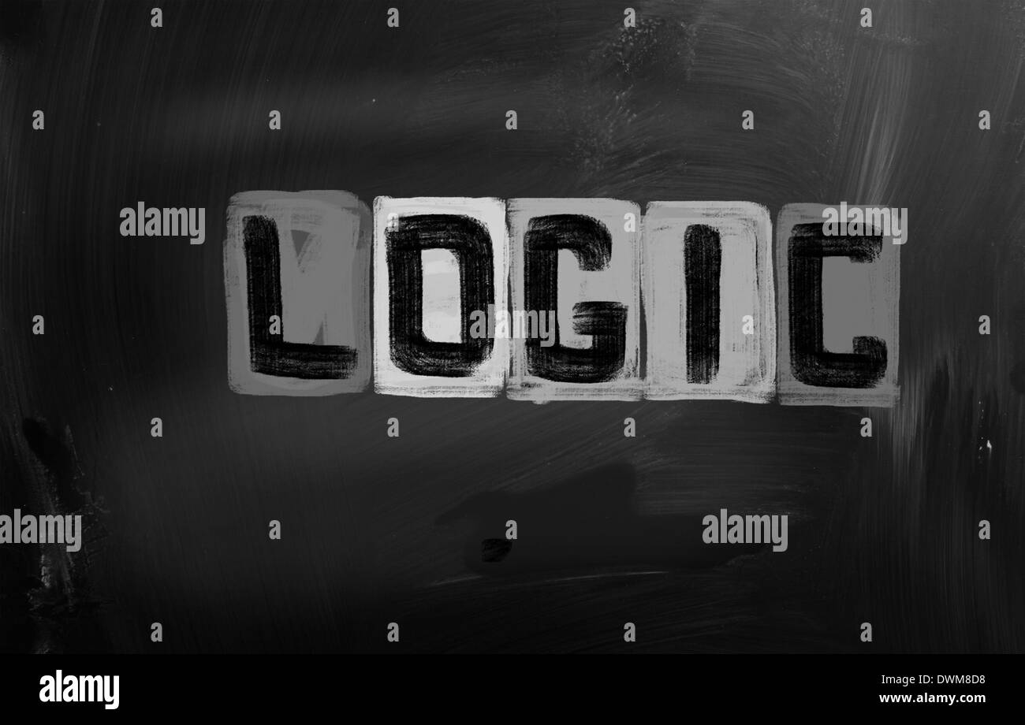
Dataset Business Logic
Training Hours: Reflects employee skill development and career growth intent. Employees investing more time in training may seek better job opportunities.
Experience & Last New Job: Indicates career stability. Employees with frequent job changes or mid-level experience often show higher attrition risk.
Company Size & Company Type: Influences job security, growth opportunities, and work environment, directly affecting employee retention.
Education Level & Major Discipline: Higher qualifications may increase external job opportunities and job mobility.
City Development Index: Represents economic development and availability of alternative employment opportunities.
Relevant Experience: Employees with less relevant experience may look for roles better aligned with their skills.
These features collectively help identify employees at risk of leaving, enabling proactive retention strategies.

Slide 9

Exploratory Data Analysis
Exploratory Data Analysis was performed to understand the structure, quality, and patterns within the dataset.
The distribution of the target variable revealed a class imbalance, indicating fewer employees seeking for job change.
Categorical features such as education level, company type, and gender were analyzed against the target to identify behavioral trends.
Numerical features including training hours and city development index were examined to observe their influence on job change decisions.
Correlation analysis helped identify relationships between numerical features and guided feature selection.
EDA insights supported effective preprocessing, feature engineering, and model selection.

Slide 10
Statistical Analysis Section
Anova:
This statistical analysis is performance is using for numerical features.
The table summarizes test statistics and p-values, highlighting features that show statistically significant relationships with the target variable.
In numerical features with significant ANOVA results demonstrate meaningful differences in mean values across job change classes.
It support informed feature selection and strengthen the reliability of the predictive modeling approach.
ANOVA TEST RESULTS
Feature: city_development_index F-statistic: 2531.7162 P-value: 0.000000
Feature: training_hours F-statistic: 8.9228 P-value: 0.002820
CHI-SQUARE TEST RESULTS
Feature: gender Chi-square value: 117.3772 P-value: 0.000000
Feature: relevent_experience Chi-square value: 315.3386 P-value: 0.000000
Feature: enrolled_university Chi-square value: 463.5337 P-value: 0.000000
Feature: education_level Chi-square value: 167.2714 P-value: 0.000000
Feature: major_discipline Chi-square value: 64.2199 P-value: 0.000000
Feature: company_size Chi-square value: 1161.9575 P-value: 0.000000
Feature: company_type Chi-square value: 959.8300 P-value: 0.000000
Feature: city Chi-square value: 2998.7772 P-value: 0.000000
Chi-Square Test:
This statistical analysis is performance is using Chi-Square tests for categorical features.
The table summarizes test statistics and p-values, highlighting features that show statistically significant relationships with the target variable.
Categorical features with low p-values indicate strong associations with employee job change behavior.
It support informed feature selection and strengthen the reliability of the predictive modeling approach.

Slide 11
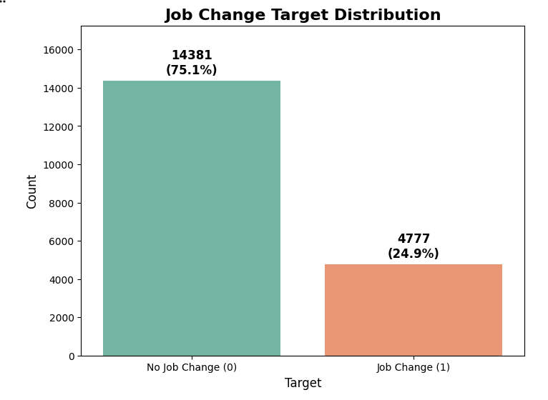
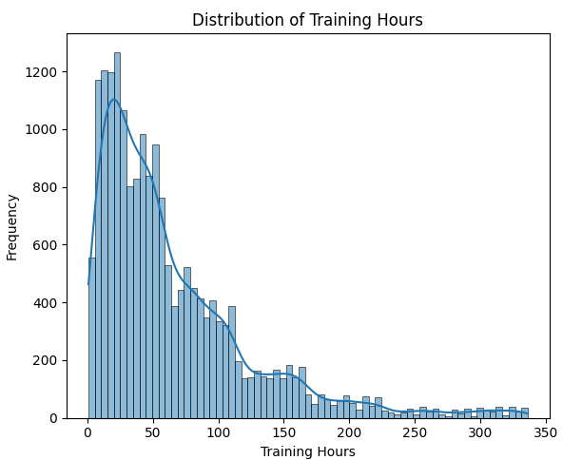
Target Variable Analysis:
The target variable indicates whether an employee is looking for a job change.
It is a binary variable where 0 represents no job change and 1 represents job change.
The distribution of the target variable is imbalanced, with fewer employees actively seeking a job change.
Due to this imbalance, evaluation metrics such as Precision–Recall are preferred over accuracy.
2. Distibution of Training Hours:
The distribution of training hours is positively skewed.
Most employees have lower training hours, while a small number have significantly higher values.
This right-skewed distribution indicates the presence of outliers.
Such skewness may influence model learning and is handled during preprocessing.

Slide 12
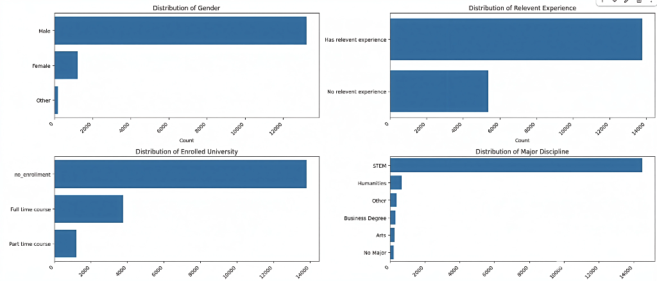
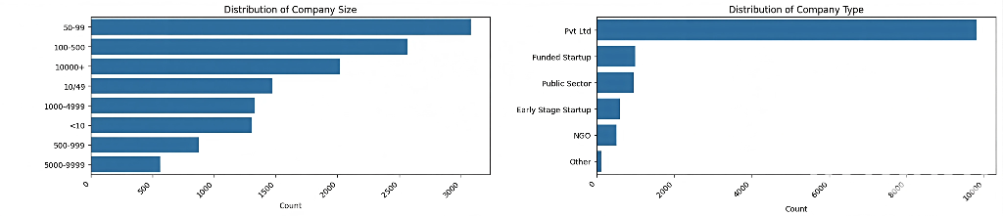
City Development Index: Employees are mostly concentrated in moderately to highly developed cities.
Distribution Of Categorical Variable
Gender: Most employees are male, with females being less represented.
Education Level: Majority of employees have a Bachelor’s degree; Masters and Doctorate degrees are less common.
City Development Index: Employees are mostly concentrated in moderately to highly developed cities.
Experience Level / Years of Experience: Certain experience brackets (e.g., 2–5 years) dominate the workforce.
Company Size: Most employees work in mid-sized companies; very large and very small companies are less frequent.
Department / Job Role: Some roles are more common than others, highlighting workforce concentration in specific areas.

Slide 13
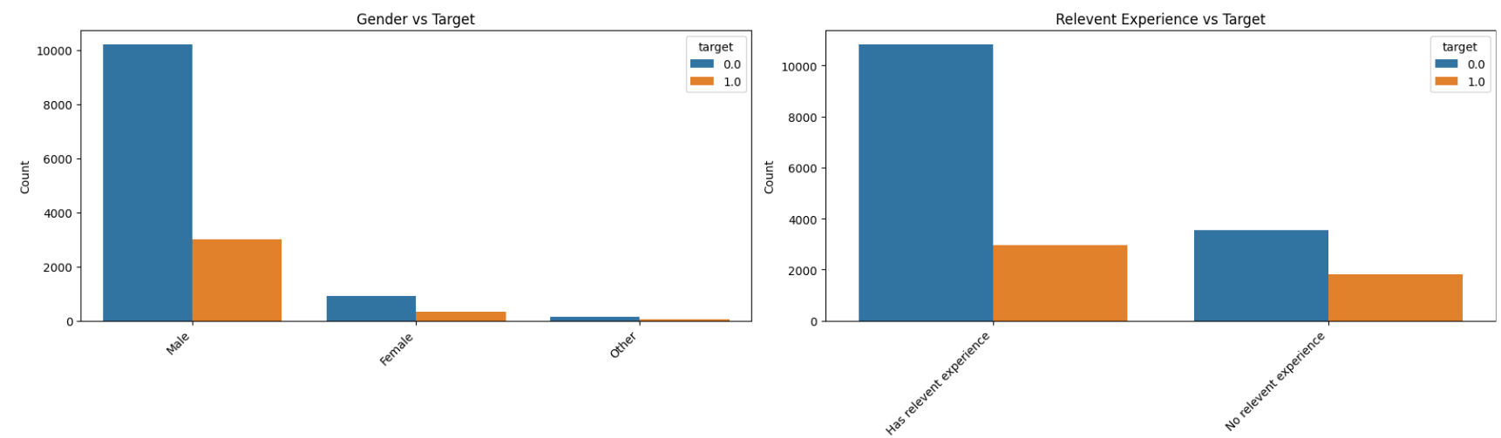
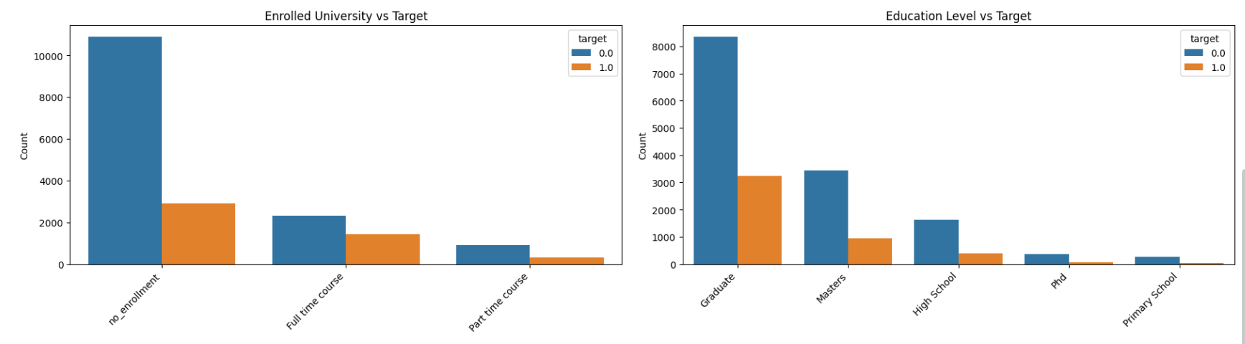
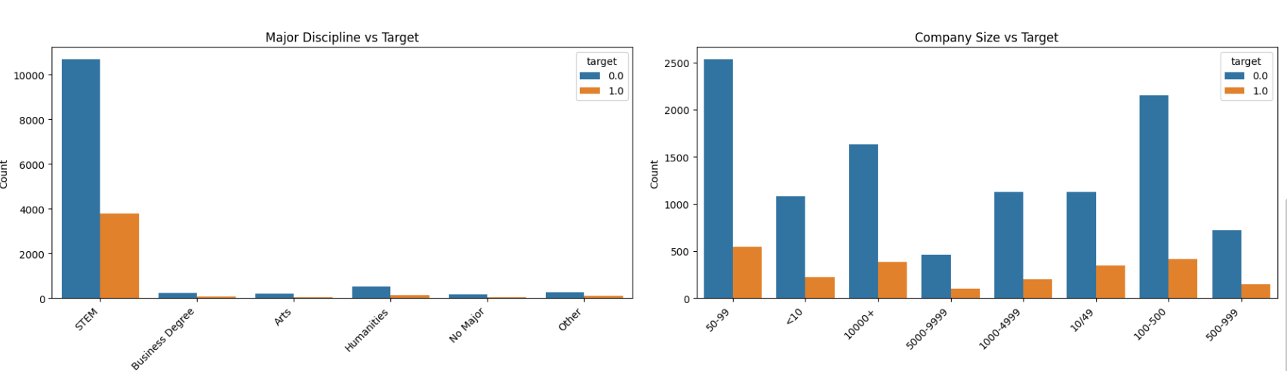
Categorical Feature VS Target
(Target: 1 = Looking for Job Change, 0 = Not Looking)
Gender: Male employees show a higher proportion of job change intent compared to female employees.
Relevant Experience: Employees with less relevant experience are more likely to look for a job change, while highly experienced employees tend to stay.
Education Level: Employees with higher education levels (Masters/PhD) show a slightly higher tendency to seek job changes, possibly due to better external opportunities.
Company Size: Employees working in smaller and mid-sized companies exhibit a higher proportion of job change intent compared to those in large organizations.
Company Type: Employees from private companies are more likely to look for a job change than those from public or government-linked organizations.
Last New Job (Category): Employees who recently switched jobs show a higher likelihood of looking for another opportunity.
Major Discipline / Job Role: Certain roles show higher job mobility, indicating domain-specific attrition trends.

Slide 14
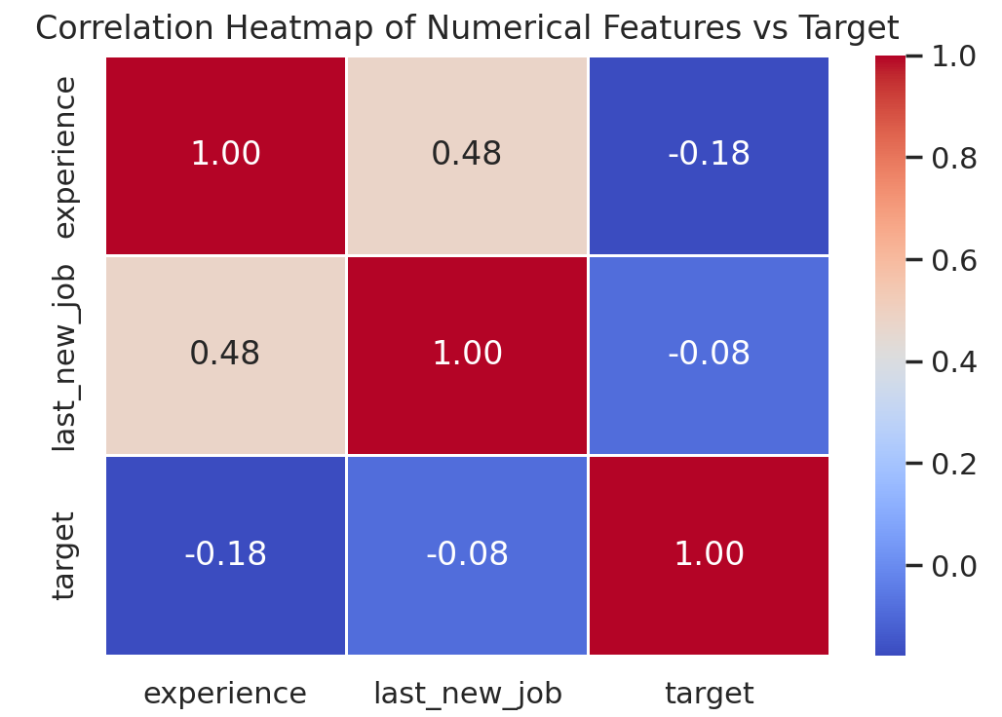
Correlation Heatmap
Target vs Training Hours: A positive correlation is observed, indicating that employees with higher training hours are more likely to look for a job change.
Target vs City Development Index: A negative correlation is seen, suggesting that employees from more developed cities tend to stay longer in their current organization.
Target vs Experience: Experience shows a weak negative correlation, implying that more experienced employees are slightly less likely to seek job changes.
Target vs Company Experience: Employees with longer tenure in the current company show a negative correlation with job change intent, indicating higher retention.
Inter-feature Correlation: Some experience-related features show moderate correlation with each other, but no strong multicollinearity is observed.

Slide 15

PREPROCESSSING
Irrelevant Feature Removal: All features in the dataset appears to be relevant based on EDA. We will retain all the columns, ensuring no valuable information is lost, especially given the dataset’s small size.
Missing Value Treatment: Missing values were handled using appropriate imputation techniques to avoid excessive data loss.
Outliers were analyzed using the IQR method. Due to the small dataset size and robustness of tree-based models such as Random Forest and XGBoost, outliers were retained to avoid loss of valuable information.
Categorical Feature Encoding: One-Hot Encoding was applied to nominal categorical features such as gender, company type, education level, company size, and major discipline, as these variables do not have any inherent order.
Feature Scaling: Feature scaling is important for machine learning algorithms that are sensitive to the magnitude and scale of input features, such as Logistic Regression. However, not all algorithms require scaling; tree-based models like Random Forests are scale-invariant.

Slide 16



MODEL SELECTION
Models used:
Logistic Regression: Logistic Regression was used as a baseline binary classification model to estimate the probability of employee job change. Its simplicity and interpretability help in understanding how individual features influence attrition risk.
Random Forest Algorithm: Random Forest was applied to capture non-linear relationships and complex feature interactions among employee attributes. Its ensemble nature improves robustness and reduces overfitting, leading to better predictive performance.
XGBoost: XGBoost is an advanced gradient boosting algorithm designed to enhance model accuracy and efficiency. It builds models sequentially to correct previous errors, making it highly effective for predicting employee job change likelihood in complex datasets.

Slide 17
Advantage of Models Use
Logistic Regression:
Simple and fast to train.
Easy to interpret and explain to HR teams.
Provides probability scores for attrition risk.
Random Forest:
Handles non-linear relationships effectively.
Robust to outliers and noisy data.
Reduces overfitting through ensemble learning.
XGBoost:
High prediction accuracy and strong generalization.
Handles complex feature interactions efficiently.
Performs well on structured and imbalanced datasets.

Slide 18
Disadvantages of Models Used
Logistic Regression:
Assumes linear relationship between features and target
Underfits complex patterns in employee behavior
Random Forest:
Less interpretable compared to Logistic Regression
Computationally more expensive for large datasets
XGBoost:
Requires careful hyperparameter tuning
More complex and less interpretable
Higher computational cost

Slide 19
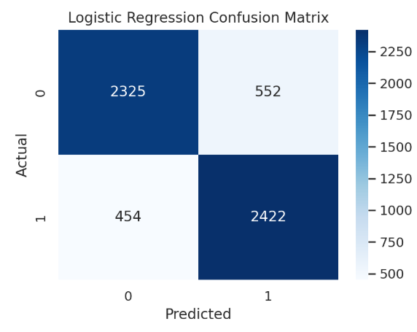
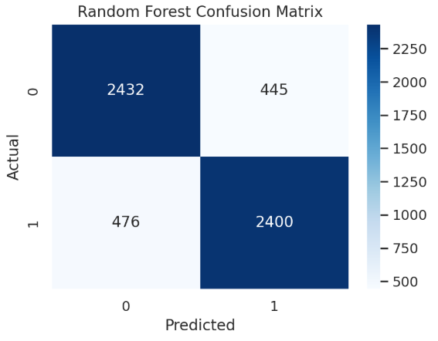
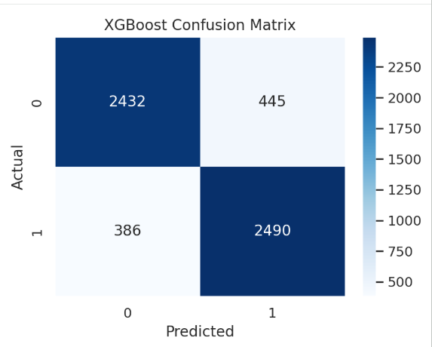
Confusion Matrix
Logistic Regression:
True Negative = 2325
False Positive = 552
False Negative = 454
True Positive = 2422
It identifies many employees correctly, but produces a relatively higher number of false negatives, indicating underfitting and limited ability to capture complex attrition pattern.
Term | Meaning
True Positive (TP) | Employee correctly predicted as likely to leave
False Negative (FN) | Employee likely to leave but predicted as stable (most dangerous)
False Positive (FP) | Employee predicted to leave but actually stayed
True Negative (TN) | Employee correctly predicted as stable
Random Forest:
True Negative = 2432
False Positive = 445
False Negative = 476
True Positive = 2400
It improves stability prediction and reduces false positives, but still misclassifies some high-risk employees as stable.
XGBoost: (BEST MODEL)
True Negative = 2432
False Positive = 445
False Negative = 386
True Positive = 2490
It achieves the lowest false negatives and the highest true positives, making it the most effective model for identifying employees at high risk of leaving.

Slide 20
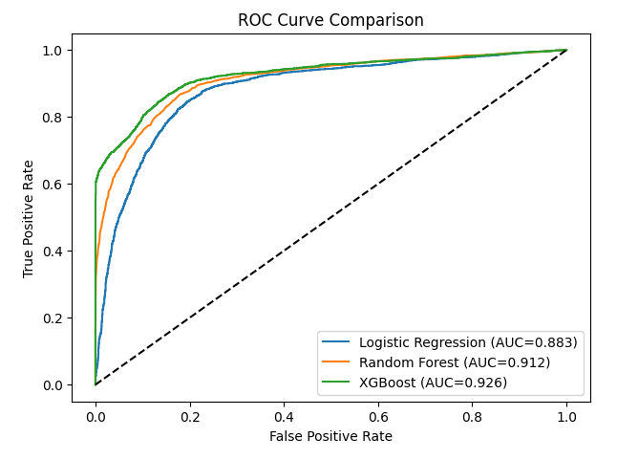
ROC Curve Comparison
The ROC curve evaluates model performance by analyzing the trade-off between True Positive Rate and False Positive Rate across different classification thresholds.
XGBoost achieved the highest AUC score (0.926), indicating superior ability to distinguish between employees likely to leave and those likely to stay.
Random Forest (AUC = 0.912) also shows strong discriminatory power.
Logistic Regression (AUC = 0.883) performs comparatively lower due to its linear decision boundary.
XGBoost is the most effective model for employee retention prediction as it provides better class separation and lower misclassification risk.

Slide 21
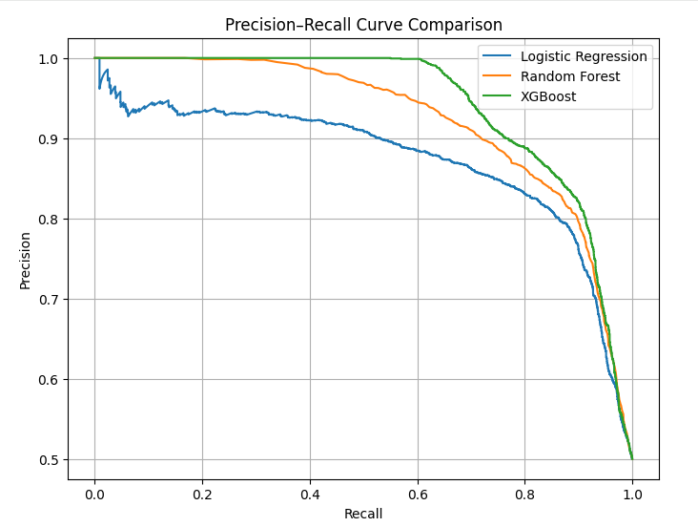
Precision – Recall Curve Comparison
The Precision–Recall curve is used to evaluate model performance on an imbalanced dataset.
It illustrates the trade-off between precision (correct positive predictions) and recall (ability to identify actual positives).
Logistic Regression shows a faster decline in precision as recall increases, indicating limited modeling capacity.
Random Forest performs better by maintaining higher precision across a wider recall range.
XGBoost demonstrates the most stable and superior performance, achieving higher precision even at high recall values.
XGBoost is selected as the best-performing model due to its optimal balance between precision and recall, making it suitable for predicting employee job change.

Slide 22


Accuracy
ROC-AUC
F1-Score
%
%
%
Understanding
Logistic Regression | 82 | 88 | 82
Random Forest Classifier | 85 | 91 | 85
XGBoost | 85 | 92 | 85
Precision: The accuracy of the model when it claims to have found something.
Recall: Recall: The ability of a model to find all the relevant cases
F1 Score: A balance between recall and precision, useful when both false positives and false negatives need to be minimized.
Experimental Results :
Logistic Regression: LR achieves 82% accuracy and ROC-AUC(88%) but lower F1-Score (82%).
Random Forest : RF algorithms maintain 85% accuracy, ROC-AUC (91%) F1-Score(85%).
XGBoost : XGBoost achieves 85% accuracy and ROC-AUC (92%) , F1-Score (85%).

Slide 23






Conclusion
Conclusion
Key Findings
The results indicated that the Random Forest and XGBoost Machine model had the highest accuracy of 85%
The study utilized the Employee Retention Prediction dataset with 1900 + instances, and all algorithms were implemented on Google Colab Jupyter Notebook.
The accuracies of all algorithms were above 80% with the lowest accuracy of 82% given by Logistic Regression and the highest accuracy given Random Forest and XGBoost as previously mentioned.
Limitations
The dataset is historical and static, so real-time employee behavior is not captured.
Some features rely on self-reported data, which may introduce bias.
External factors such as salary, work-life balance, and organizational culture are not included.
Model predictions depend heavily on data quality; missing or incorrect inputs can affect accuracy.
The model is trained on a specific dataset and may require retraining for other organizations or regions.
Future research
Integrate real-time HR data for continuous monitoring and prediction.
Include additional features such as salary trends, performance ratings, and employee satisfaction scores.
Deploy the model as a dashboard or web application for HR teams.
Explore deep learning models for further performance improvement.
Apply explainable AI (SHAP values) to improve transparency and trust in predictions.

Slide 24


